Slide 1
BRFS US Discount Sensitivity Model
Customer Data Science
June 2017

Slide 2
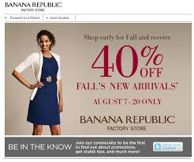

Background
Objective:
Every year company shells out billions of $ in various discounts offered.
Not all Customers have affinity towards discounts to make a purchase.
This creates an opportunity to improve margin by offering relevant discounts to customers based on how discount sensitive they are.
The whole exercise will help in:
Increasing Revenue
Saving Cost
Approach :
We find the probability of customers searching for 20% discount using classification algorithms.

Slide 3
Modeling Details
Scope: BRFS US
Algorithm: Xgboost
Data : Store and Online Transaction and
Browse Data
Platforms & Packages: Hive, R
Observation Window
Prediction Window
Training(Intime)
03/01/2015- 02/29/2016
03/01/2016- 02/28/2017
Out of time Validation
03/01/2014- 02/29/2015
03/01/2015- 02/29/2016
Data Preparation
Experimenting with various classification algorithms
Finalizing Algorithm using Cross Validation
Training Data : 3.34 million customer-keys
Intime Training Data : 3.34 million customer-keys
Out of Time Testing Data : 2.08 million customer-keys
Testing and Validation for intime and out-of-time data using the final models.
Out of 1350 Xgboost models 20 models were finalized and used for intime and out of time testing
Model Performance Metrics Evaluation

Slide 4
Predictors and Relative Importance

Slide 5
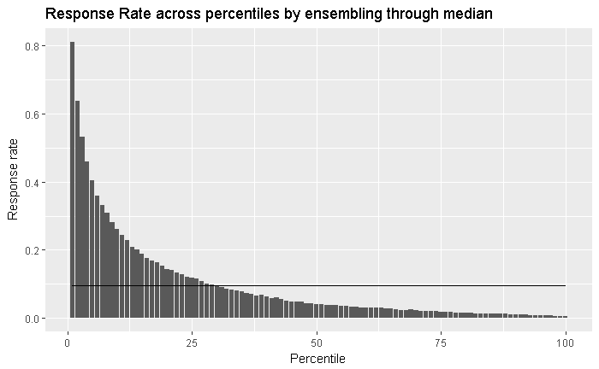
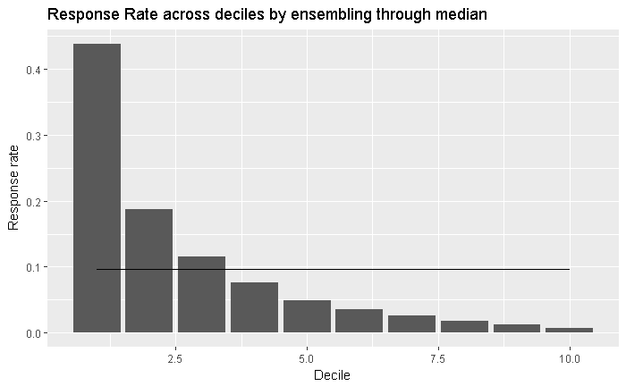
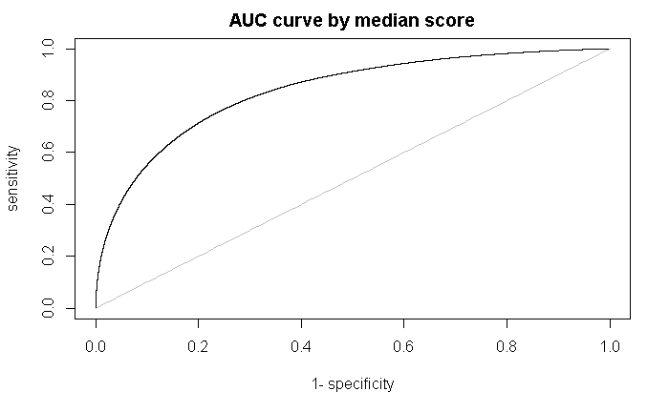
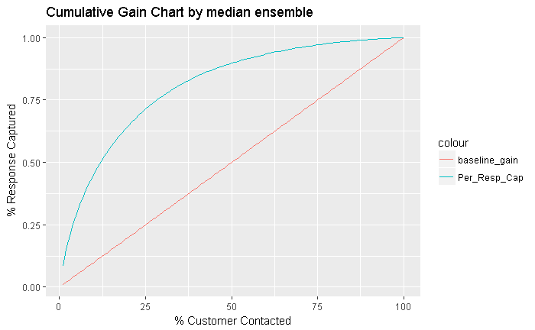
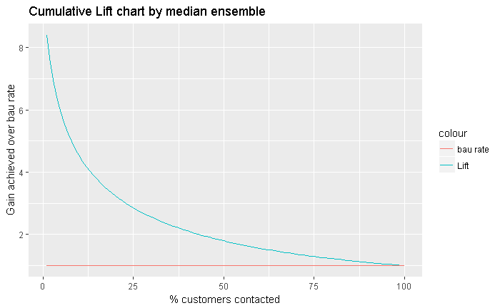
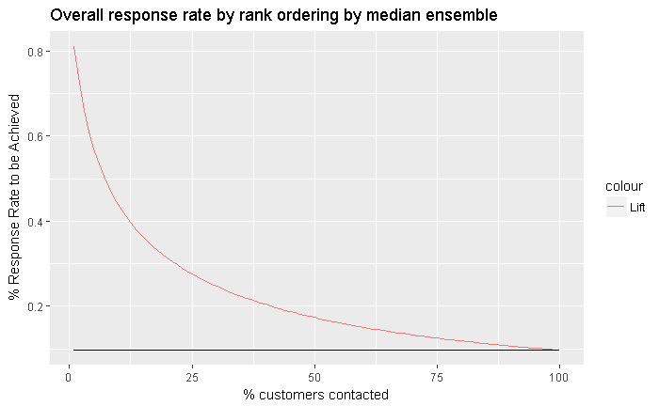
Model Performance on Intime Validation Data
March ’15 - Feb ’16

Slide 6
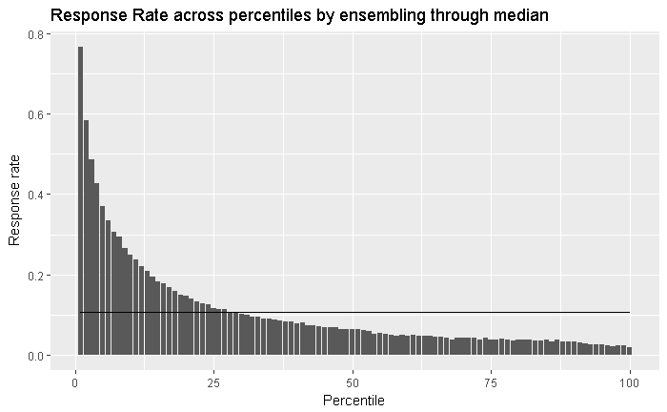
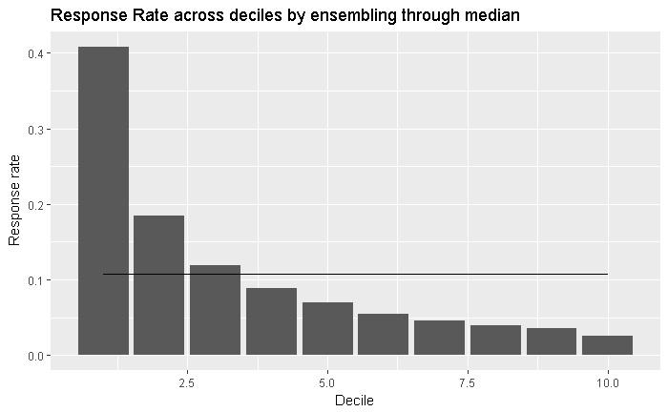
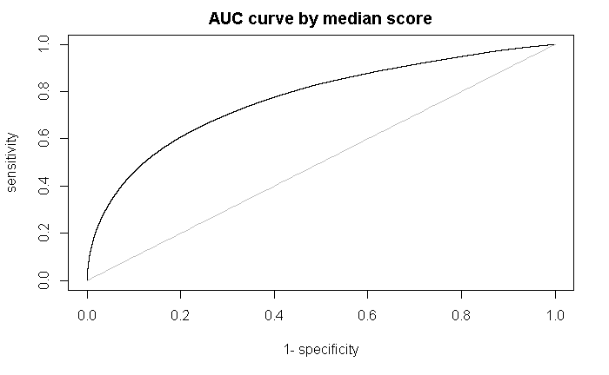
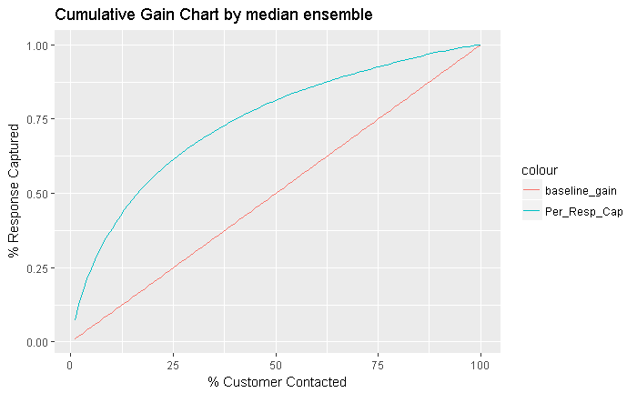
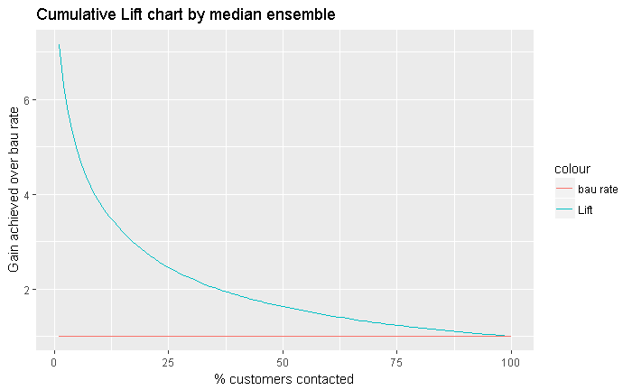
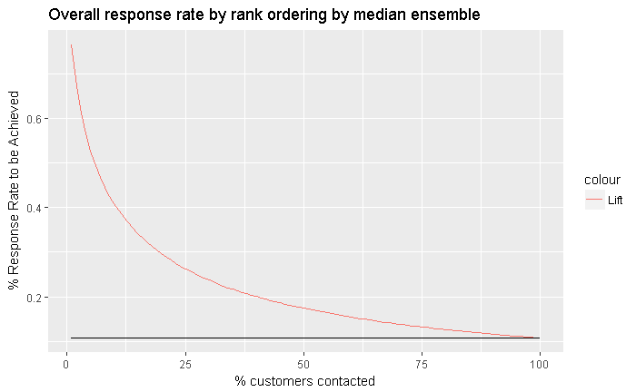
Model Performance on Out of time Validation Data
March ’14 - Feb ’15

Slide 7
Thank You

